Slide 1
Social Distancing in Education
April 17, 2020
Notes:
Social distancing, or physical distancing, is a set of non-pharmaceutical interventions or measures taken to prevent the spread of a contagious disease by maintaining a physical distance between people and reducing the number of times people come into close contact with each other. Wikipedia

Slide 2
SOCIAL DISTANCING IN EDUCATION
Social Distancing Design Considerations
Spatial Considerations
Spatial Considerations
Consider recommended mandates when designing classrooms which vary by state, city, region, and district and may change daily so solutions should be flexible and agile to morph as current guidelines are updated.
Consider the impact of social distancing to manage infectious diseases in the classroom and the reality that class sizes will likely be reduced in the near term.
Consider 6’ spacing between students initially to comply with CDC recommendations which may be reduced as the threat relaxes.
Consider fewer transitions into different learning modes to minimize active interactions during this time of heightened sensitivity.
Consider ways to enable visual connections between learners, instructor and content to enhance student engagement.
Consider removing the instructor desk/podium or turn it away from students to reduce the threat of transmissions.
Consider wider pathways and unidirectional flow in and out of the building, classroom, corridors, breakout in-between spaces to give more distance between students as they travel through the school.
Social distancing, or physical distancing, is a set of non-pharmaceutical interventions or measures taken to prevent the spread of a contagious disease by maintaining a physical distance between people and reducing the number of times people come into close contact with each other. Wikipedia
Notes:
Social distancing, or physical distancing, is a set of non-pharmaceutical interventions or measures taken to prevent the spread of a contagious disease by maintaining a physical distance between people and reducing the number of times people come into close contact with each other. Wikipedia
Suggested requirements are changing daily as the condition intensifies and will continue to change as the thread is reduced over time.

Slide 3
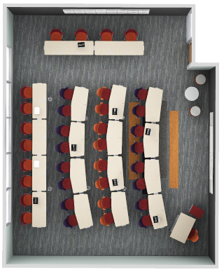
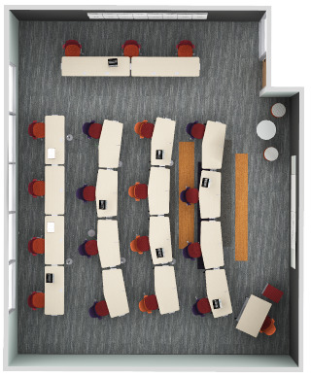
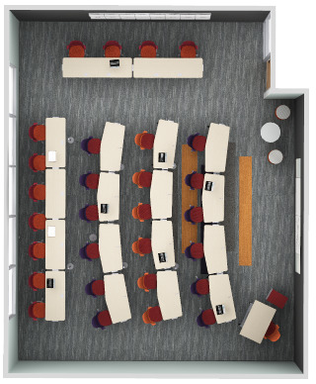
SOCIAL DISTANCING IN EDUCATION
Classroom A | Before & During Social Distancing
Plan Views
TYPICAL CLASSROOM BEFORE SOCIAL DISTANCING
36 students
SAME CLASSROOM WITH 6’ SOCIAL DISTANCING
19 students
SAME CLASSROOM WITH 3’ SOCIAL DISTANCING
29 students
28’6” x 34’11” = 976 SF
Remove chairs at existing classroom tables to allow for social distancing of 6’ between students. Add chairs as restrictions relax to achieve a more relaxed spacing of 3’ between people (as shown on right), then bring all 36 chairs back when conditions fully recover.

Slide 4
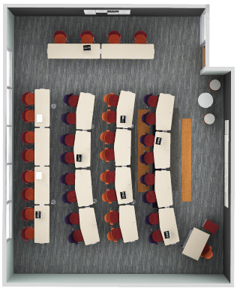
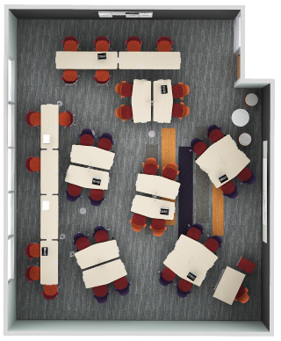
SOCIAL DISTANCING IN EDUCATION
Classroom A | Before Social Distancing
Plan Views
PRESENTATION MODE
GROUP BREAKOUT MODE
28’6” x 34’11” = 976 SF
36 students = 27 SF per student
Typical active learning classroom layout.

Slide 5
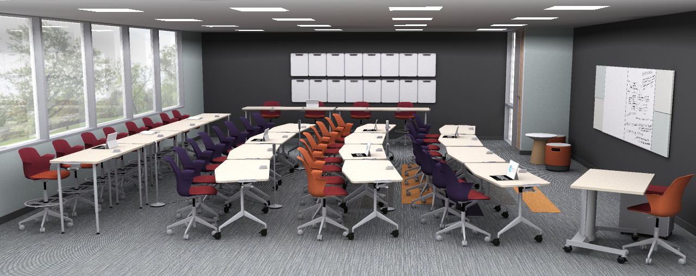
SOCIAL DISTANCING IN EDUCATION
Classroom A | Before Social Distancing
Presentation Mode
28’6” x 34’11” = 976 SF
36 students = 27 SF per student
Typical active learning classroom layout.

Slide 6
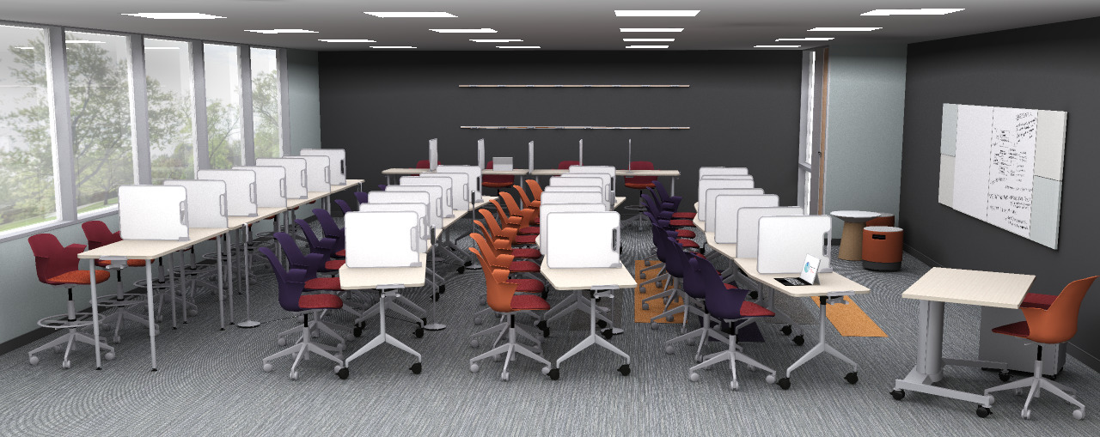
SOCIAL DISTANCING IN EDUCATION
Classroom A | Option A with Social Distancing
Presentation Mode
28’6” x 34’11” = 976 SF
36 students = 27 SF per student
Typical active learning classroom layout using Verb Personal Whiteboards as a quick social distancing measure.

Slide 7
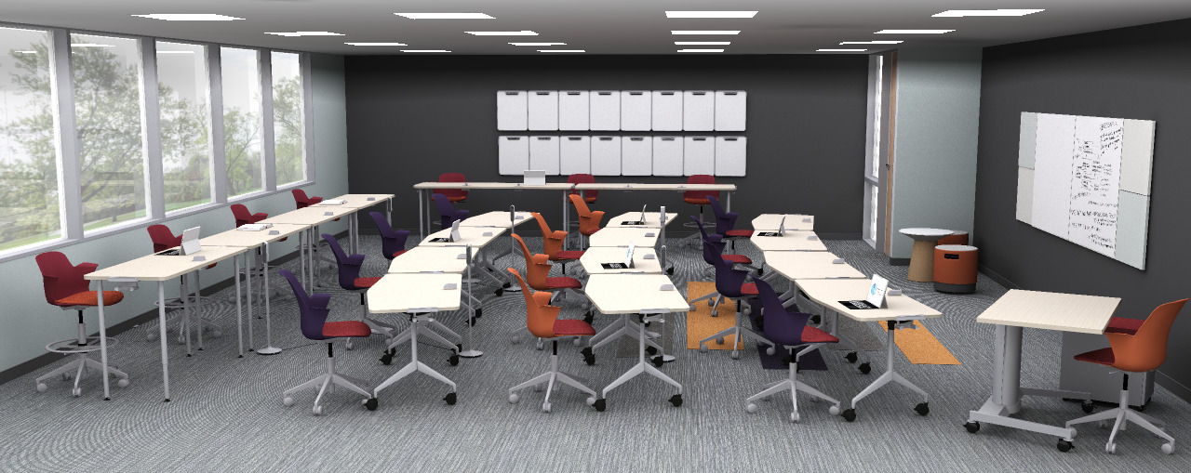
SOCIAL DISTANCING IN EDUCATION
Classroom A | Option B | 6’ Social Distancing
Presentation Mode
28’6” x 34’11” = 976 SF
19 students = 51 SF per student
Remove chairs at existing tables to allow for 6’ social distancing.

Slide 8
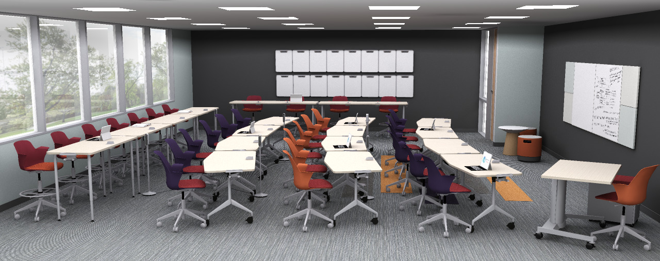
SOCIAL DISTANCING IN EDUCATION
Classroom A | Option C | 3’ Social Distancing
Presentation Mode
28’6” x 34’11” = 976 SF
29 students = 34 SF per student
Add chairs as restrictions relax to achieve a more relaxed spacing of 3’ between people, then bring all 36 chairs back when conditions fully recover.

Slide 9
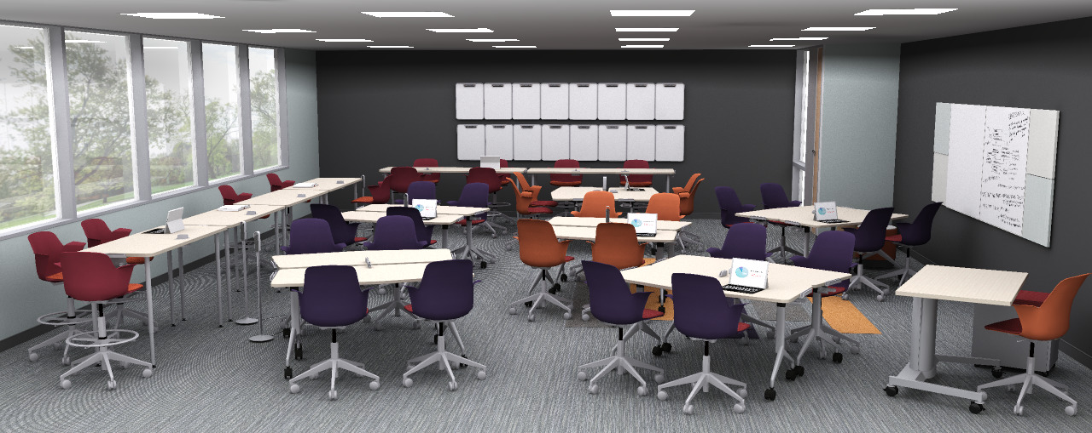
SOCIAL DISTANCING IN EDUCATION
Classroom A | Before Social Distancing
Group Breakout Mode
28’6” x 34’11” = 976 SF
36 students = 27 SF per student
Typical active learning classroom layout.

Slide 10
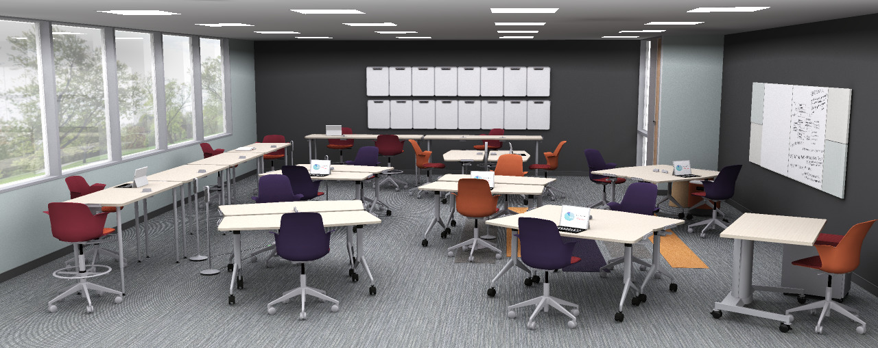
SOCIAL DISTANCING IN EDUCATION
Classroom A | Option B | 6’ Social Distancing
Group Breakout Mode
28’6” x 34’11” = 976 SF
19 students = 51 SF per student
Remove chairs at existing tables to allow for 6’ social distancing.

Slide 11
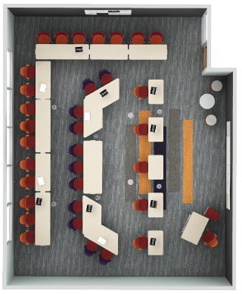
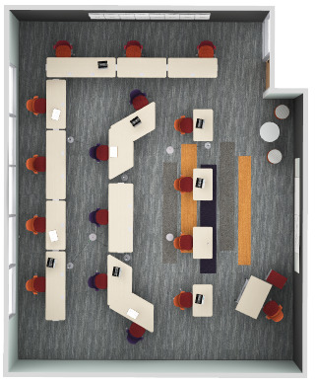
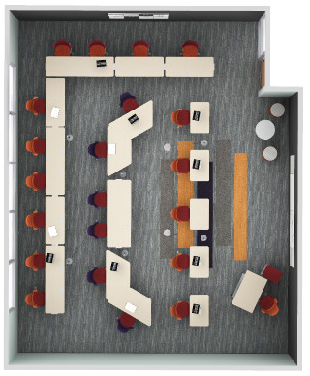
SOCIAL DISTANCING IN EDUCATION
Classroom B | Varying Levels of Social Distancing
Plan Views
TYPICAL CLASSROOM
NO SOCIAL DISTANCING
33 students
SAME CLASSROOM
WITH 6’ SOCIAL DISTANCING
16 students
SAME CLASSROOM
WITH 3’ SOCIAL DISTANCING
21 students
28’6” x 34’11” = 976 SF
21 students = 46 SF per student
Remove chairs at existing tables to allow for social distancing. Add chairs as restrictions relax to achieve a more relaxed spacing of 3’ between people (as shown), then bring all 33 chairs back when fully recovered.

Slide 12
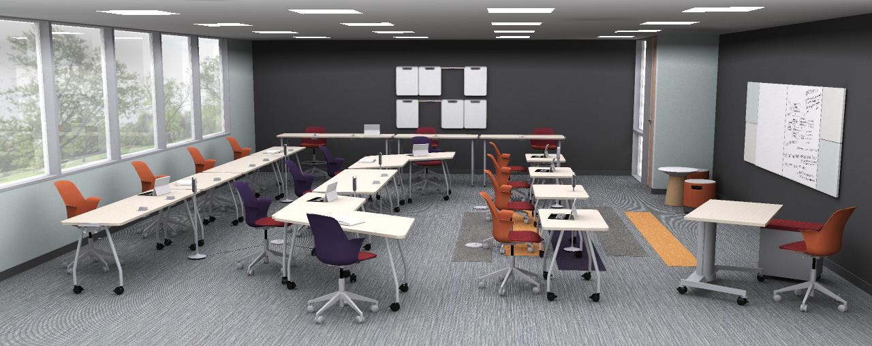
SOCIAL DISTANCING IN EDUCATION
Classroom B | 6’ Social Distancing
Presentation Mode
28’6” x 34’11” = 976 SF
16 students = 61 SF per student
Remove chairs at existing tables to allow for social distancing. Add chairs as restrictions relax to achieve a more relaxed spacing of 3’ between people (as shown), then bring all 30 chairs back when fully recovered.

Slide 13
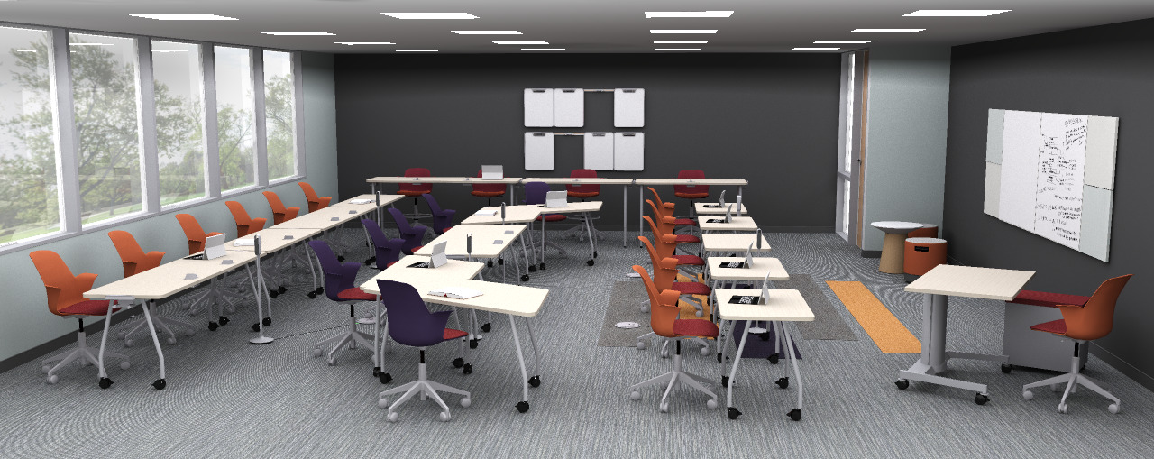
SOCIAL DISTANCING IN EDUCATION
Classroom B | 3’ Social Distancing
Presentation Mode
28’6” x 34’11” = 976 SF
21 students = 46 SF per student
Remove chairs at existing tables to allow for social distancing. Add chairs as restrictions relax to achieve a more relaxed spacing of 3’ between people (as shown), then bring all 30 chairs back when fully recovered.

Slide 14
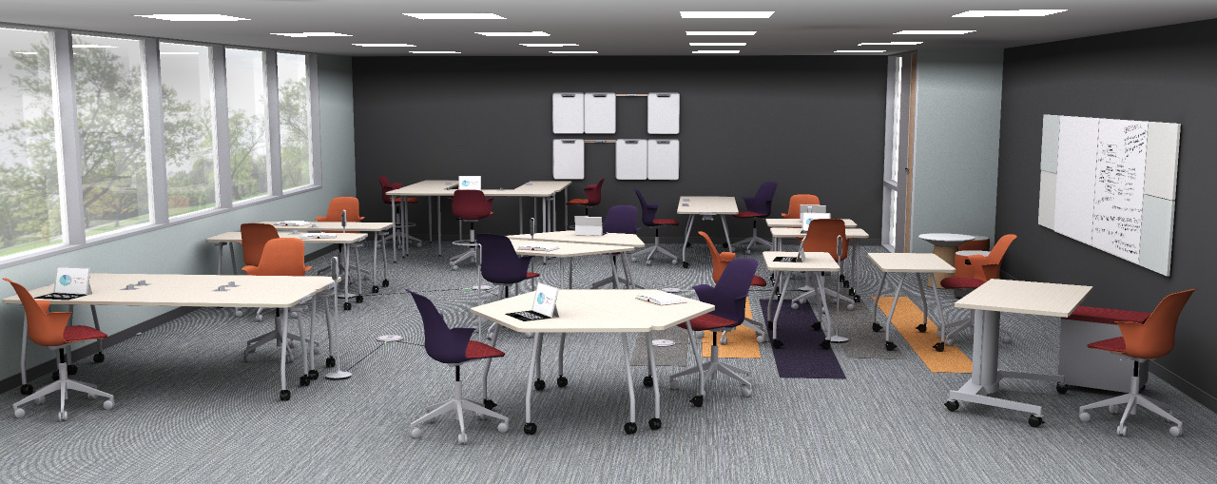
SOCIAL DISTANCING IN EDUCATION
Classroom B | 6’ Social Distancing
Group Breakout Mode
28’6” x 34’11” = 976 SF
16 students = 61 SF per student
Remove chairs at existing tables to allow for social distancing. Add chairs as restrictions relax to achieve a more relaxed spacing of 3’ between people (as shown), then bring all 30 chairs back when fully recovered. .

Slide 15
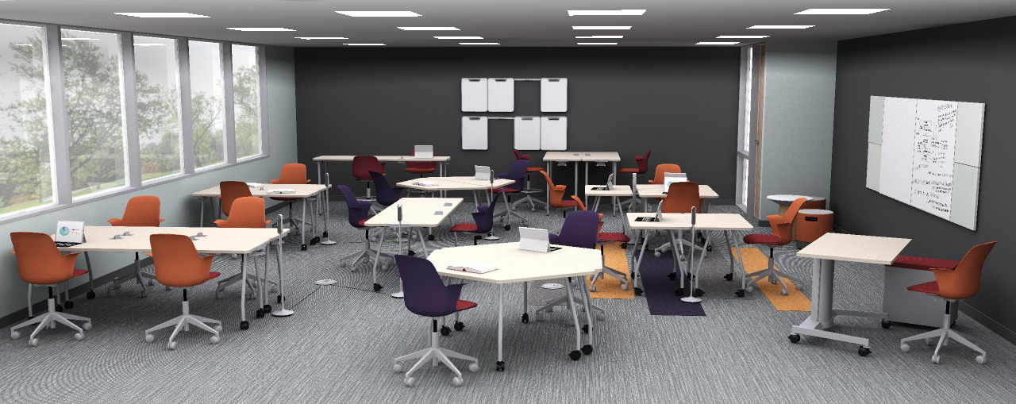
SOCIAL DISTANCING IN EDUCATION
Classroom B | 3’ Social Distancing
Group Breakout Mode
28’6” x 34’11” = 976 SF
21 students = 46 SF per student
Remove chairs at existing tables to allow for social distancing. Add chairs as restrictions relax to achieve a more relaxed spacing of 3’ between people (as shown), then bring all 30 chairs back when fully recovered. .

Slide 16
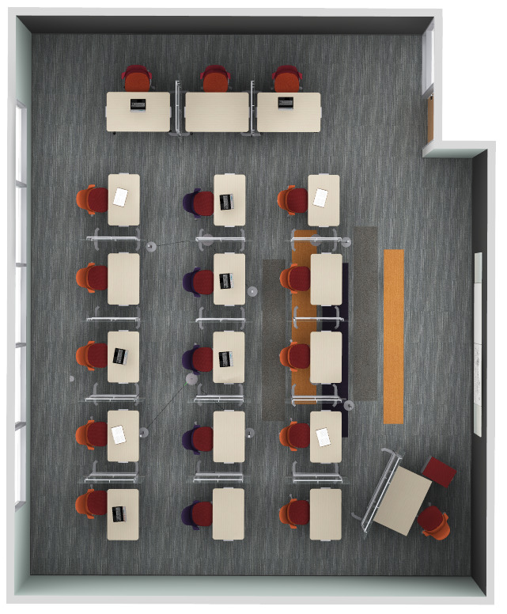
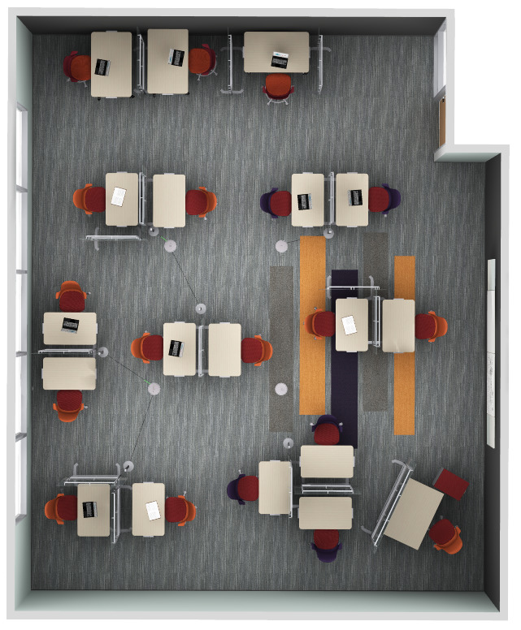
SOCIAL DISTANCING IN EDUCATION
Classroom C | Individual Tables w/ Freestanding Separation Screens
Plan Views
PRESENTATION MODE
GROUP BREAKOUT MODE
28’6” x 34’11” = 976 SF
18 students = 54 SF per student
This scenario provides additional protection between students with plexiglass Freestanding Separation Screens.
As a result, student count is reduced from 30 to 18 students.

Slide 17
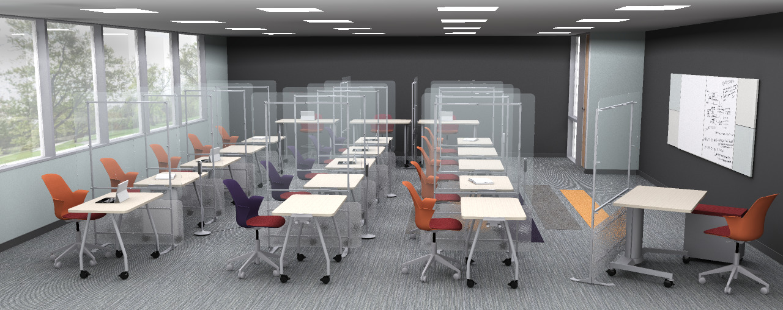
SOCIAL DISTANCING IN EDUCATION
Classroom C | Individual Tables w/ Freestanding Separation Screens
Presentation Mode
28’6” x 34’11” = 976 SF
18 students = 54 SF per student
This scenario provides additional protection between students with plexiglass Freestanding Separation Screens.
As a result, student count is reduced from 30 to 18 students.

Slide 18
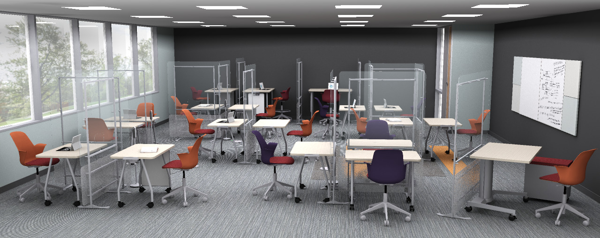
SOCIAL DISTANCING IN EDUCATION
Classroom C | Individual Tables w/ Freestanding Separation Screens
Group Breakout Mode
28’6” x 34’11” = 976 SF
18 students = 54 SF per student
This scenario provides additional protection between students with plexiglass Freestanding Separation Screens.
As a result, student count is reduced from 30 to 18 students.

Slide 19
In-Between Focus Spaces

Slide 20
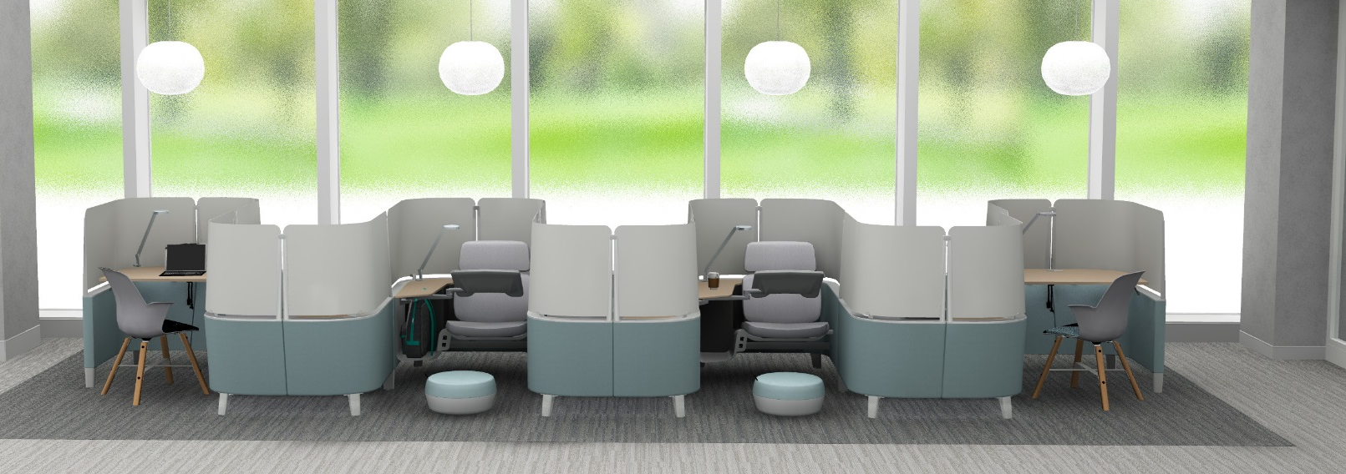
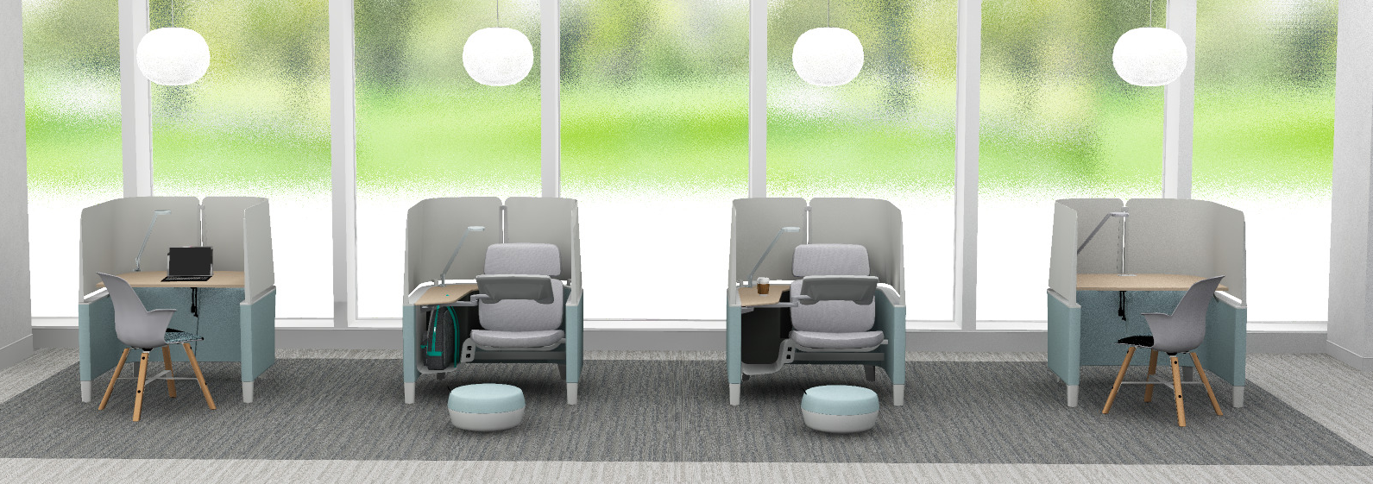
SOCIAL DISTANCING IN EDUCATION
In-Between Spaces | Brody Desk & Lounge
Individual Micro-Environment
Without Social Distancing.
With Social Distancing.
Separate Brody in a student commons setting, them replace them adjacent when social distancing restrictions relax.

Slide 21
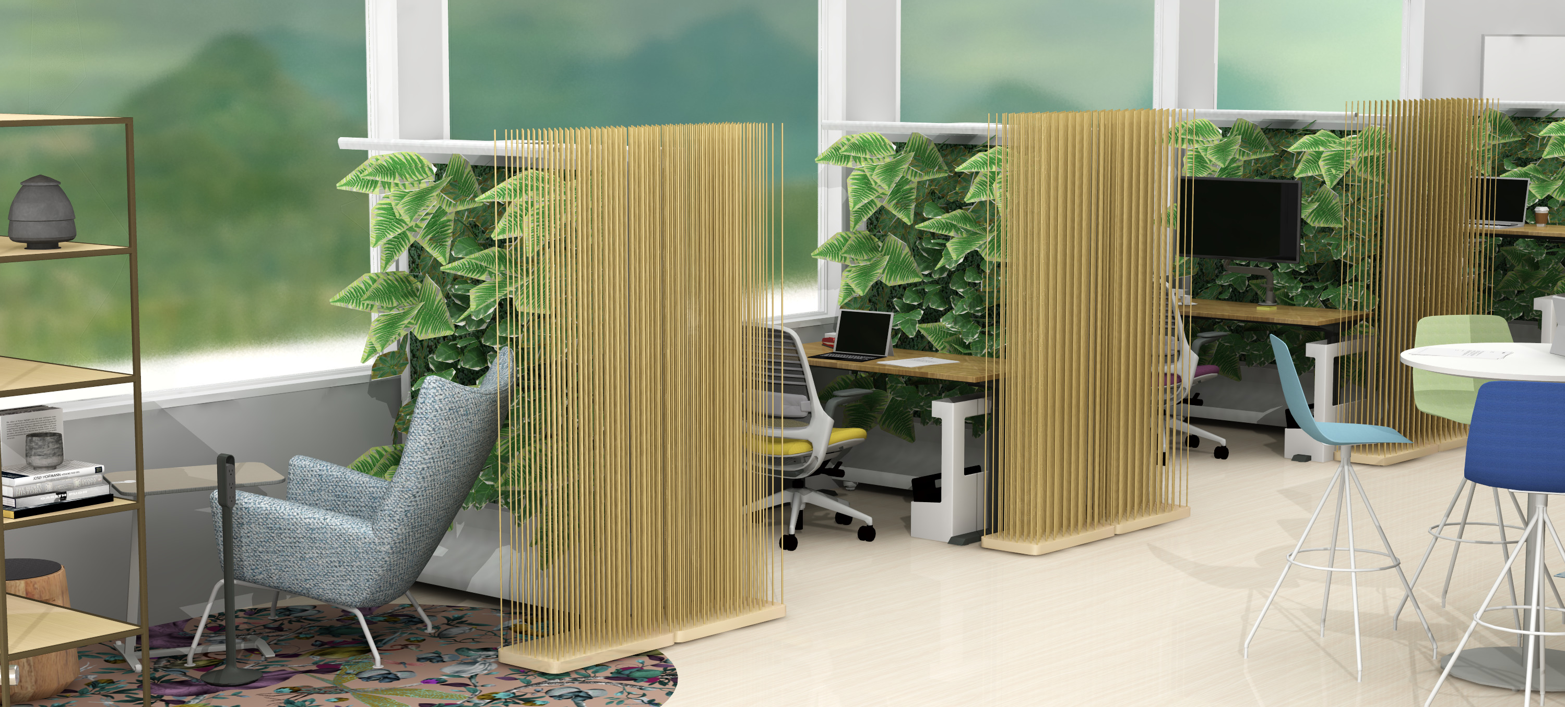
SOCIAL DISTANCING IN EDUCATION
In-Between Spaces | Brody Desk & Lounge
Individual Settings
Provide a variety of individual settings where students can study, focus and rejuvenate alone at a safe distance from others.

Slide 22
Love How You Learn

Slide 23
Appendix

Slide 24
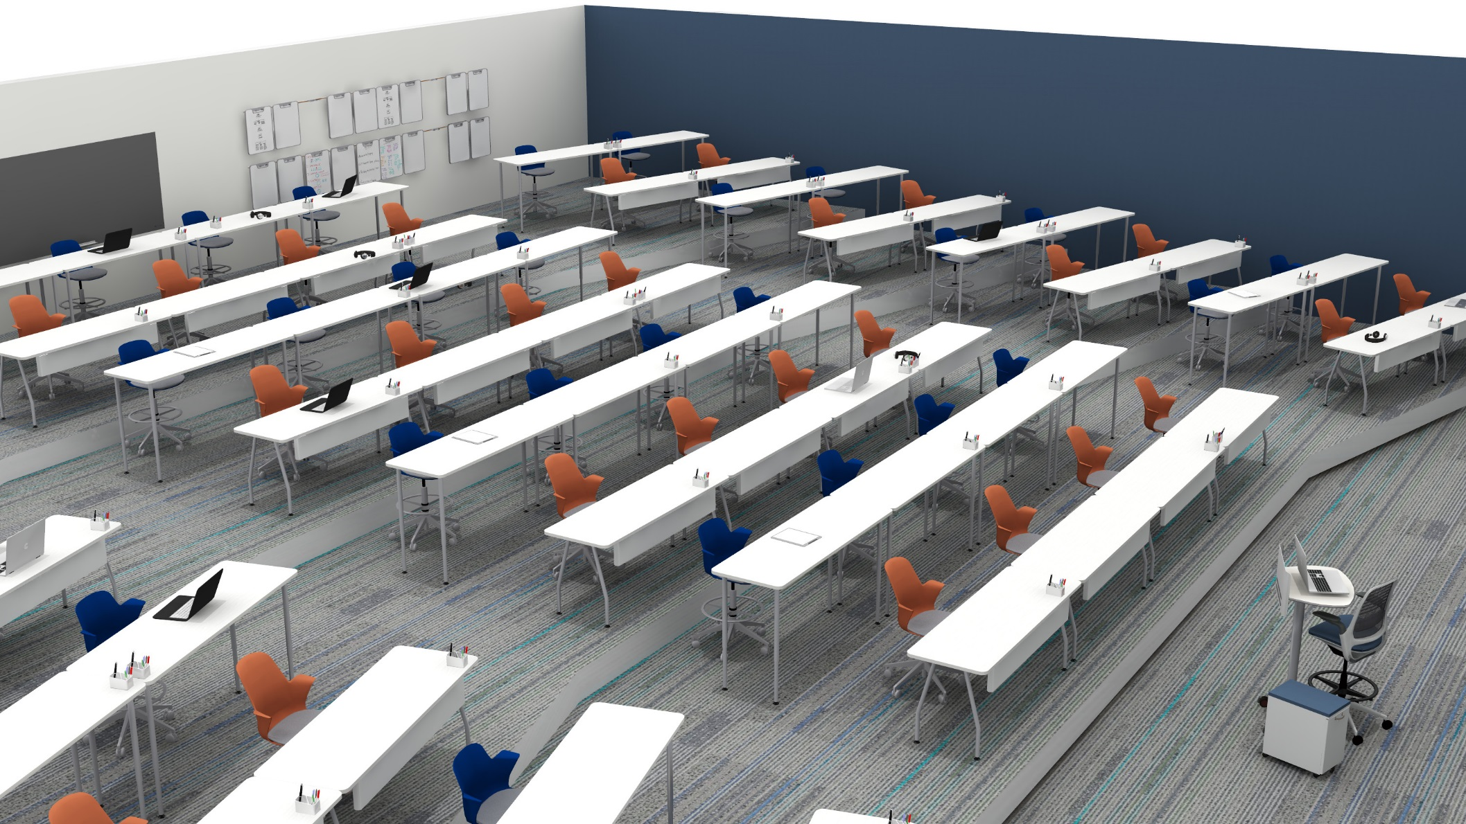
SOCIAL DISTANCING IN EDUCATION
Classroom D | Large Lecture Hall
Presentation Mode
64’8” x 62’6” = 976 SF
64 students = 63 SF per student
Density in a lecture hall is significantly reduced, but will allow for chairs to be added as the threat lessens.

Slide 25
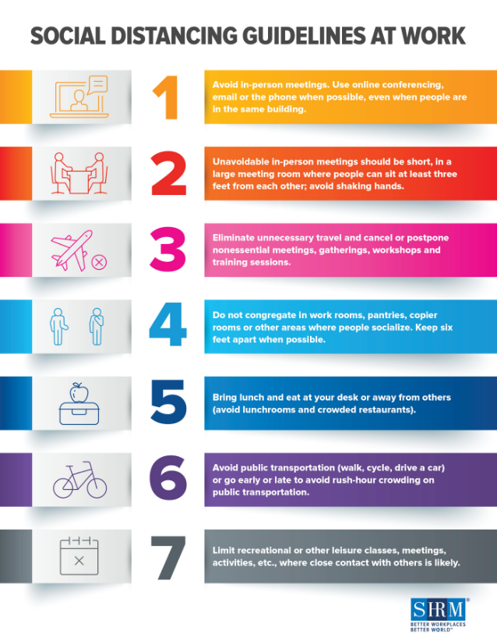
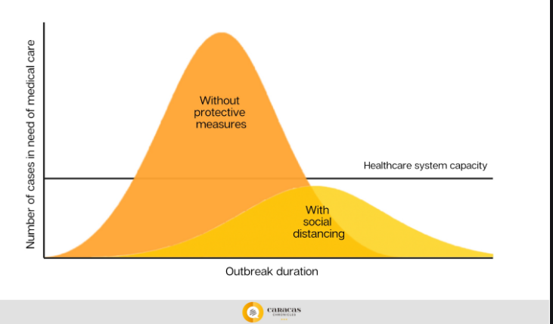
SOCIAL DISTANCING IN EDUCATION
Social Distancing Design Considerations
Guideline Examples
Images may have copyright restrictions.
Notes:
Social distancing, or physical distancing, is a set of non-pharmaceutical interventions or measures taken to prevent the spread of a contagious disease by maintaining a physical distance between people and reducing the number of times people come into close contact with each other. Wikipedia
Suggested requirements are changing daily as the condition intensifies and will continue to change as the thread is reduced over time.

Slide 26
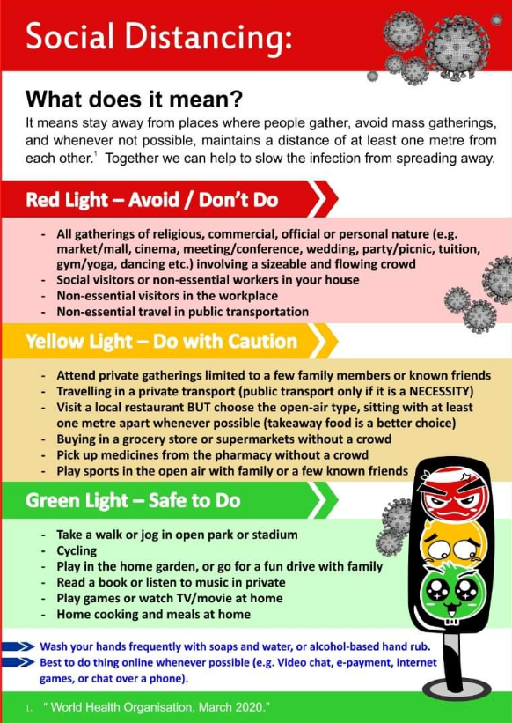
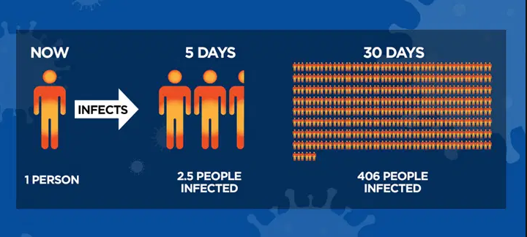
SOCIAL DISTANCING IN EDUCATION
Social Distancing Guidelines
Poster Examples
Images may have copyright restrictions.
Notes:
Social distancing, or physical distancing, is a set of non-pharmaceutical interventions or measures taken to prevent the spread of a contagious disease by maintaining a physical distance between people and reducing the number of times people come into close contact with each other. Wikipedia

