Slide 1
Rapid Response
Wall Thoughtstarters – Privacy Wall Cornice Height
03/23/2020

Slide 2
Privacy Wall Thoughtstarters

Slide 3
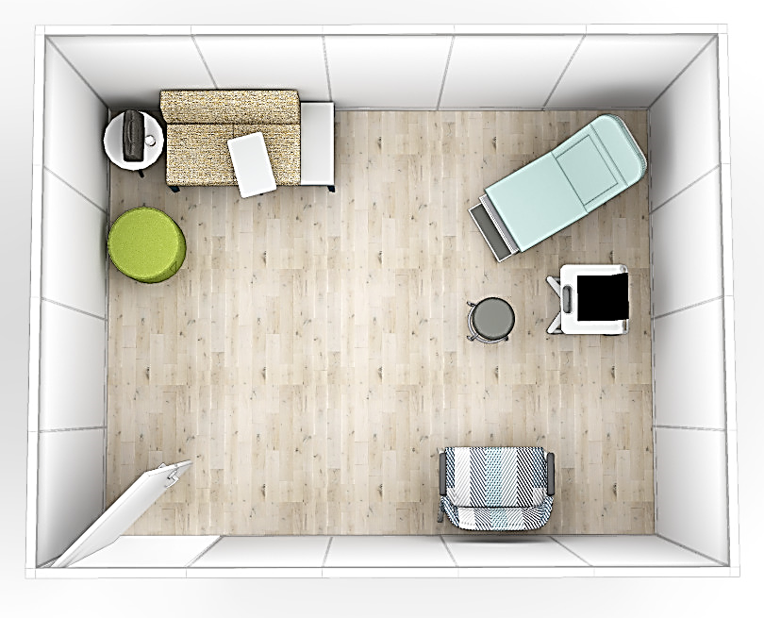
LARGE EXAM ROOM with front (15’-9”w x 12’-5”d x 8’-0”h)
ISOMETRIC VIEW
PLAN VIEW

Slide 4
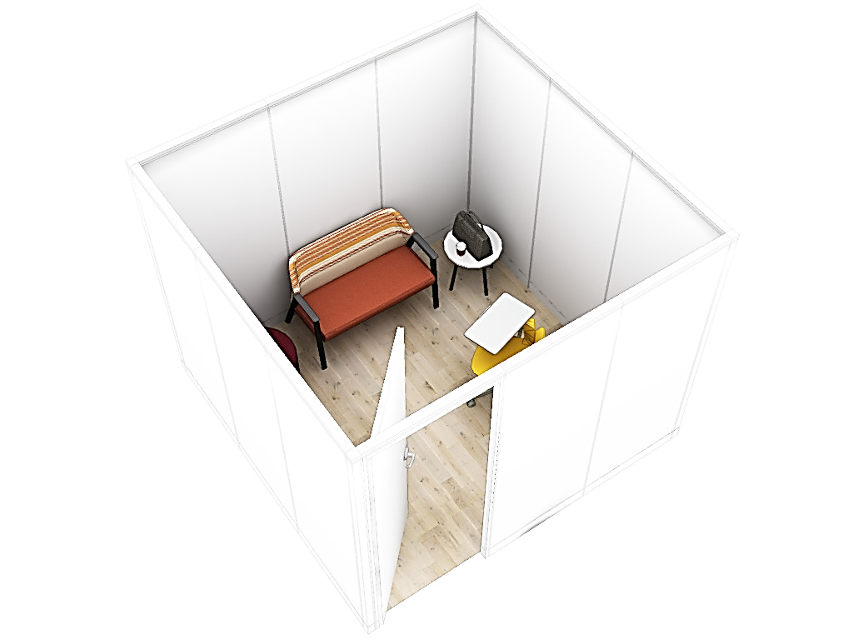
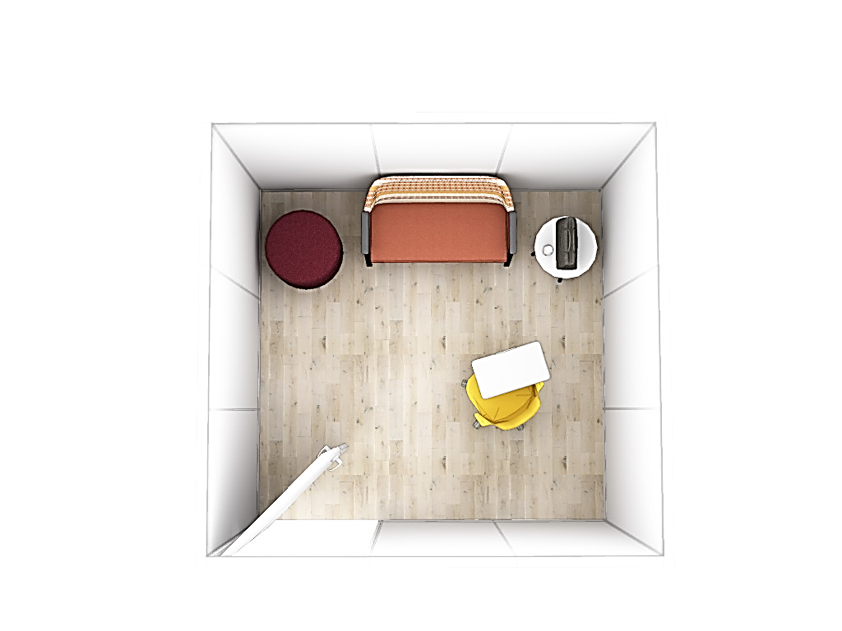
SMALL EXAM ROOM with front (9’-9”w x 9’-5”d x 8’-0”h)
ISOMETRIC VIEW
PLAN VIEW

Slide 5
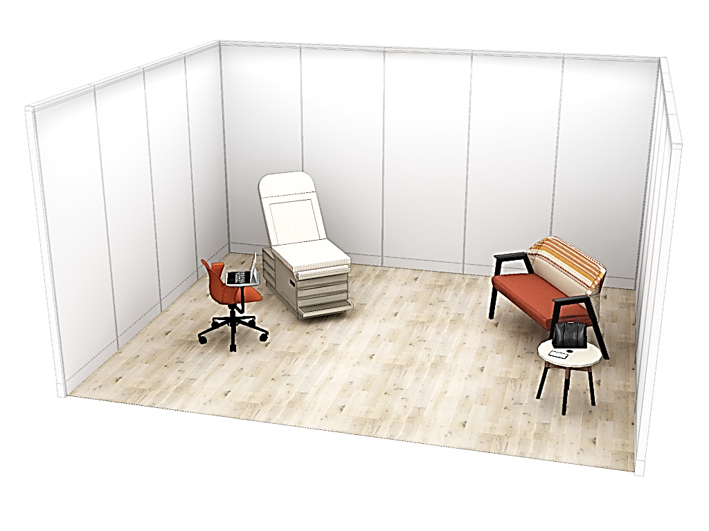
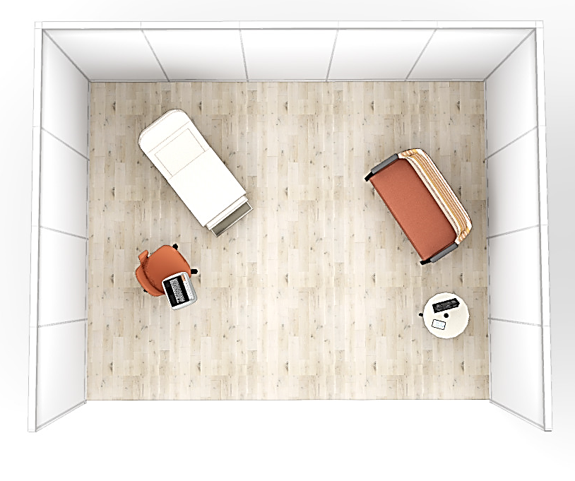
LARGE EXAM ROOM with no front (15’-9”w x 12’-5”d x 8’-0”h)
ISOMETRIC VIEW
PLAN VIEW

Slide 6
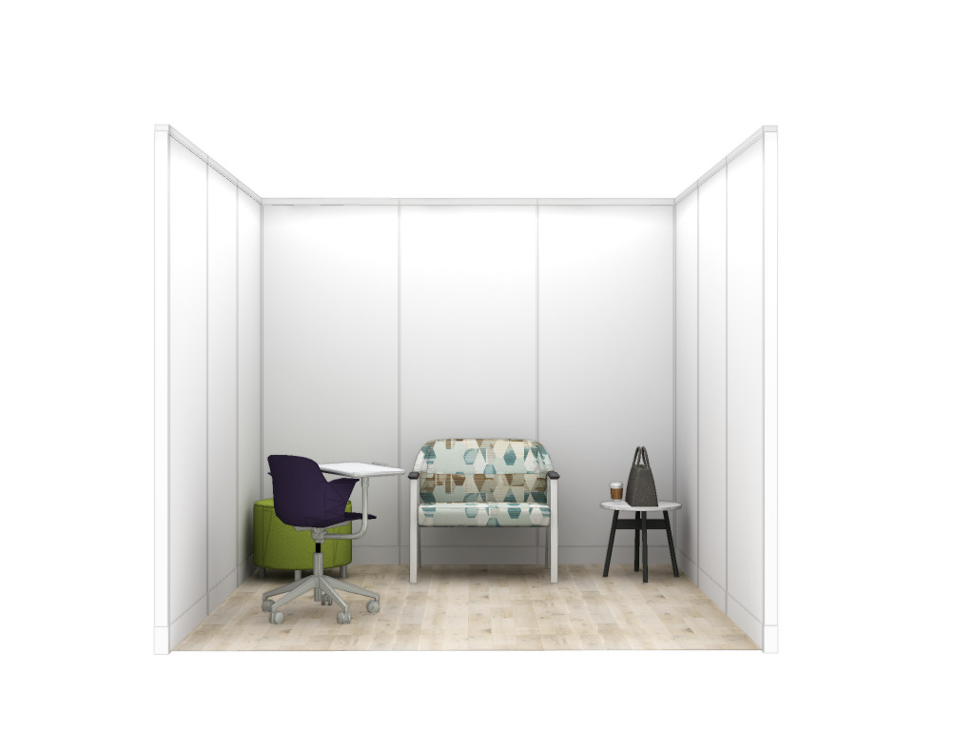
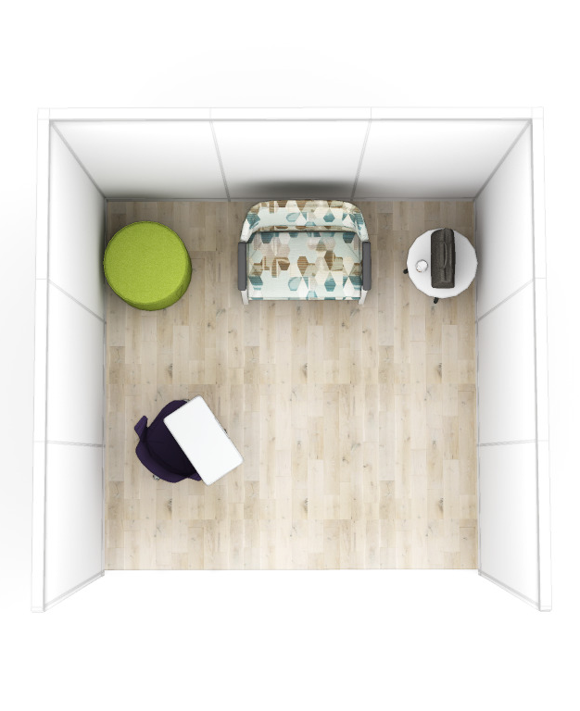
SMALL EXAM ROOM with no front (9’-9”w x 9’-5”d x 8’-0”h)
ELEVATION VIEW
PLAN VIEW

Slide 7
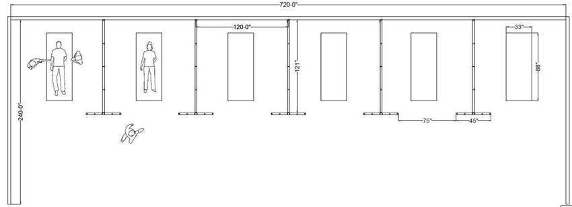
SEPARATION WALLS
with 3’-9” wing walls
(10’-0”w x 10’-0”d x 8’-0”h)
PLAN VIEW
ISOMETRIC VIEW

